Slide 1
走进(近)Scrum

Slide 2
Class Agenda
Agile Overview
Scrum Overview
Scrum Roles
Scrum Artifacts
Scrum Events
The Sprint
Appendix

Slide 3
Agile Overview

Slide 4
Agile manifesto
We are uncovering better ways of developing software by doing it and helping others do it. Through this work we have come to value:
Individuals and Interactions over Processes and Tools
Working Software over Comprehensive Documentation
Customer Collaboration over Contract Negotiation
Responding to Change over Following a Plan
That is, while there is value in the items on the right, we value the items on the left more.

Slide 5
Agile manifesto
The 12 Agile Principles:
Our highest priority is to satisfy the customer through early and continuous delivery of valuable software.
Welcome changing requirements, even late in development. Agile processes harness change for the customer’s competitive advantage.
Deliver working software frequently, from a couple of weeks to a couple of months, with a preference to the shorter timescale.
Business people and developers must work together daily throughout the project.

Slide 6
Agile manifesto
Build projects around motivated individuals. Give them the environment and support they need, and trust them to get the job done.
The most efficient and effective method of conveying information to and within a development team is face-to-face conversation.
Working software is the primary measure of progress.
Agile processes promote sustainable development. The sponsors, developers and users should be able to maintain a constant pace indefinitely.
Continuous attention to technical excellence and good design enhances agility.

Slide 7
Agile manifesto
Simplicity—the art of maximizing the amount of work not done—is essential.
The best architectures, requirements and designs emerge from self-organizing teams.
At regular intervals, the team reflects on how to become more effective, then tunes and adjusts its behavior accordingly.
http://agilemanifesto.org

Slide 8
Why Agile?
Force the iteration in smaller increments
Get feedback early and often
Ensure high value
Improve predictability
Reduce risk

Slide 9
Scrum Overview

Slide 10
Scrum Is:
An Agile method of software development
A simple framework
An approach for managing complex problems
A collaborative effort
A management wrapper

Slide 11
Scrum does not:
Provide a silver bullet
Fix your problems…it simply provides a framework to guide the team to identify and solve its own problems.
Does not provide detailed plans for every contingency
Raises, promotions, job titles
Team members that are lazy, obnoxious, incompetent

Slide 12
Scrum values
Focus: Limit work-in-progress
Courage: Teams own challenges themselves
Openness: Concerns are expressed openly and solved
Commitment: Breeds ownership and success
Respect: Ignites cycles of improvement

Slide 13
The Two Keys of Scrum
Self-Organization
Empirical Process Control

Slide 14
Self-organization
On a self-organizing team, everyone plans together to figure out what work needs to be done.
During the sprint each person takes on the work that the project needs.
No single person is in command or control.
Every member of the team is responsible for understanding the team’s goals.
The whole team together is responsible for achieving the team’s goals.
The whole team is accountable to each other to do their part.

Slide 15
Empirical process control
Empiricism is evidence-based process
Scrum has two inspect and adapt loops
Daily (daily scrum or stand-up)
Sprint (sprint review/retrospective → sprint planning/backlog refinement)
Inspect
Do
Adapt

Slide 16
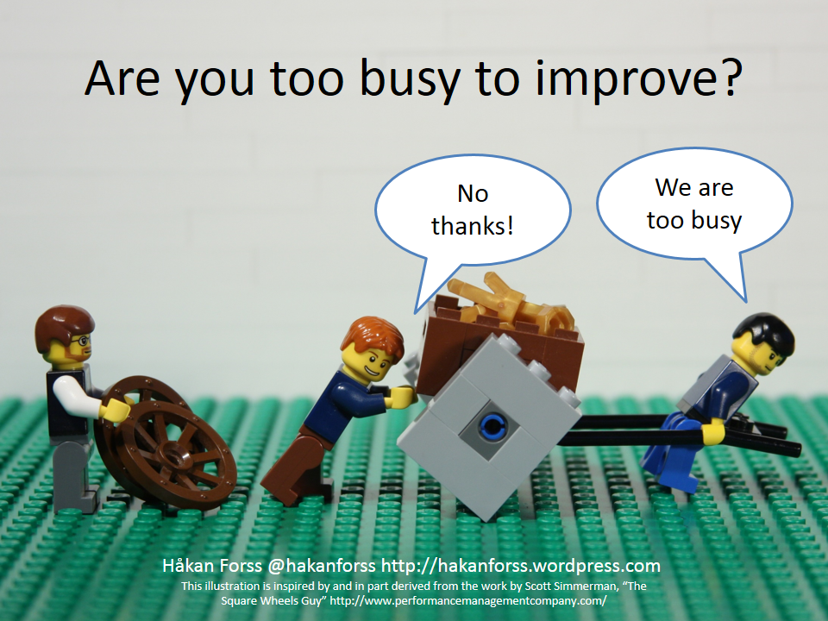
Continuous improvement

Slide 17
Scrum Roles

Slide 18
Product Manager
Voice of the Customer
Responsible for ensuring Return on Investment (ROI)
Define roadmap items
Define epics and use cases
Prioritize epics
Monitor the triple constraint (scope, schedule, budget) and make trade-off decisions
Communicate roadmap visibility for the dashboard to the Project Manager
Communicate accurate project status to business stakeholders
Respond to questions quickly, not more than 24 hours for defects and the current sprint
Note: The scrum role of Product Owner is a combination of the Product Manager and Business Analyst role.

Slide 19
Business Analyst
Coordinate grooming activities
Break down epics into user stories
Note edge cases and constraints
Ensure requirements are clear, mutually understood and well documented
Negotiate acceptance criteria
Control, manage and prioritize user stories in the Product Backlog
Move user stories into Jira sprints according to the team’s capacity
Lock sprint scope at least 3 weeks before sprint starts
Review and close user stories after completion
Ensure Ux (wireframes) are clear, complete and locked prior to grooming

Slide 20
Business Analyst
Ensure visual designs are clear, complete and locked prior to sprint planning
Respond to questions quickly, not more than 24 hours for defects and the current sprint
Note: The scrum role of Product Owner is a combination of the Product Manager and Business Analyst role.

Slide 21
Scrum Master
Broadly communicate accurate project status/health
Process expert (or facilitator of process experts)
Ensure that the framework is followed
Act as a change agent focusing on continuous improvement
Keep the team fully functional and productive
Shield the team from external interferences and impediments. (The team only works on the planned and committed sprint goal.)
Plan external dependencies
Keeps everything visible and transparent
Not an assistant or organizer of the team

Slide 22
The scrum team
In Scrum, Developers refers to all cross-functional members of the team that design, build and release the solution.
Should be 3-9 team members
Organize itself and its work according to agile principles and the scrum framework
Collaborate with the rest of the team
Follow organizational policies
Stay focused on sprint goals and commitments
Monitor the sprint burndown and escalate risk

Slide 23
Scrum artifacts

Slide 24
Product increment
A product increment is a testable and potentially shippable portion of product.
Product Manager realizes value from the investment of time in the sprint
It should be released at the end of every sprint or during the sprint for projects with continuous delivery.
Includes all items necessary to ship:
Code
Test code
Database schemas, sprints, etc.
Documentation
Specifications

Slide 25
Product Backlog
List of epics, user stories, tasks, spikes, and defects in Jira that have not been prioritized into a sprint
Defined simply as “Backlog” in Jira
Found on the Backlog tab of the project’s agile planning board, below all sprints
Includes functional, non-functional, and architectural elements
Owned and ordered by priority by the BA
Vertical slices of providing value to the customer (user)
Refined and groomed on a weekly basis

Slide 26
Sprint Backlog
A list of all product backlog items that have been accepted into a sprint
In Jira, it can be found in the Backlog tab of the project’s agile planning board
A detailed view can also be found on the Active Sprints tab
Tool for the team to manage itself during the sprint
Once the sprint is locked, it may not be changed without re-planning and re-commitment by the whole scrum team.
Once the sprint is started, the active members of the scrum team own the sprint backlog (Dev, QA).

Slide 27
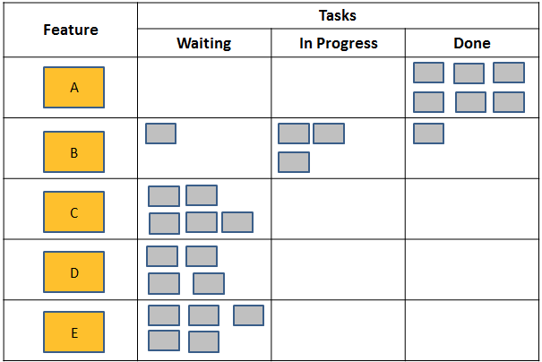
Task Board
Allows the team to see the progress of all the tasks and stories for the sprint
The team is responsible for updating and tracking their sprint backlog
Depicts what items are being worked (and by whom)

Slide 28
Sprint Burndown Chart
A visual representation of the work planned vs. the work remaining for the sprint.
Allows the team to manage itself during the sprint based on progress and to identify risks to the completion of all items by the end of the sprint
Hours worked should be logged against all tasks by the scrum team on a daily basis in order for the sprint burndown accurately reflect the sprint status.
Scrum Master is responsible for ensuring the team is aware of its burndown and encouraging the team to keep it updated.
The remaining values in red should line up with the gray line.
At the end of the sprint, the red and green lines should form a perfect X.

Slide 29
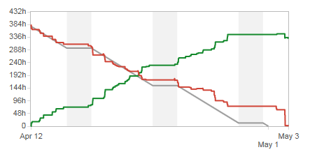
Sprint Burndown Chart

Slide 30
Definition of Done
Its purpose is to ensure that all scrum team members are aligned on precisely what “Done” means.
Checklist evaluated for all items required to ship software
It can be defined at both the user story level and the sprint level
Each scrum team should follow Active’s SDLC guidelines to develop its own Definition of Done.
Each scrum team should continue to refine and mature it’s Definition of Done as the team matures.
Teams should not compromise their Definition of Done in order to deliver a sprint on schedule.

Slide 31
Scrum Events

Slide 32
Grooming: PMO Standards
Purpose: Product Manager/BA walkthrough of the product backlog with the sprinting team, refine and break down requirements, and assign Story Point values.

Slide 33
Grooming: PMO Standards
Mandatory Attendees/Roles
BA – Expectation is that the grooming agenda is provided at least two business days before the scheduled weekly grooming to ensure Dev/QA have enough time to review the tickets in JIRA and ask questions. BA and Product Manager should have synced prior to the grooming meeting to ensure there is clear communication
Dev – Come prepared to the grooming session having reviewed the grooming agenda. Be prepared to provide SP estimate after ticket review.
QA – Come prepared to the grooming session having reviewed the grooming agenda. Be prepared to provide SP estimate after ticket review.
Project – Can be considered optional, but should make sure that the team is going through product backlog tickets efficiently, Product is answering and resolving all Dev/QA questions, and Dev/QA teams are assigning SP estimates to each ticket after the ticket is reviewed.

Slide 34
Grooming: high level
High level estimations may be used for planning when long range planning is required, but Active teams are only required to commit to 90 days of roadmap, except in special circumstances when business needs require a firm commitment.
PdM develops high level requirements with enough detail that ballpark estimates can be developed.
Development team provides rough ballpark estimates.
PjM tracks the accuracy of high level estimates and the burndown of the project in order to identify and escalate risks early.

Slide 35
Grooming: Detailed
BA schedules grooming as a weekly recurring meeting
BA explains the epics and user stories.
BA refines Acceptance Criteria based on discussions and updates Jira.
Developers decompose epics and user stories into small increments.
Once the stories are small, mutually understood and Acceptance Criteria are agreed upon by all, the scrum team estimate Story Points.
Scrum team identifies dependencies, BA writes stories and links them.
All members of the team estimate, including QA.
If there is an unresolvable mismatch in Dev and QA estimation, the highest number is used.

Slide 36
Sprint Planning
What will be delivered in the increment resulting from the upcoming sprint?
How will the work needed to deliver the increment be achieved?
Must have a current and prioritized product backlog as an input.
Confirm the team’s capacity in Story Points for the sprint.
Review the scope of the sprint, as locked by the BA 3 weeks prior.
Confirm all dependencies are planned and risks managed.
Confirm commitment of all scrum team members.
If there is a mismatch in Dev and QA capacity, the lowest number is used.
On or before the first day of the sprint, the scrum team needs to collaborate to assign user stories, add subtasks for all work and estimate hours per subtask.

Slide 37
Daily Stand-up
The purpose of the daily stand-up (or scrum) is to force the iteration in smaller increments, one day at a time.
The team answers the following questions:
What did I do yesterday?
What do I plan on doing today?
Any obstacles in my way?
The stand-up is not a status meeting.
It should be time boxed at 15 minutes per day and should not deviate from the three questions.
If further discussion is needed, wait until after it is over, so the team is not distracted from the stand-up goal.

Slide 38
Sprint Review/Demo
The sprint review meeting is held at the end of every sprint.
The development team demonstrates all the work that has been deemed “Done”.
If the team accumulated technical debt during the sprint, they may discuss it during the review and request the BA to add it to the product backlog.
Includes a review of how the marketplace or potential use of the product might have changed, which results in a revised product backlog.
Key stakeholders should be invited.

Slide 39
Sprint Retrospective
The purpose is the sprint retrospective is to inspect how the last Sprint went with regards to people, relationships, process, and tools and develop actionable plans for continuous improvement.
Typically occurs right after the sprint review.
Attended only by the scrum team, including Product Manager, BA and Scrum Master.
Team members should come prepared to answer the following three questions:
What went well?
What didn’t go well?
How can we improve?
The Scrum Master documents and tracks an actionable improvement plan.

Slide 40
The sprint

Slide 41
Sprint Overview
A sprint is a consistent amount of time that the team implements, tests and releases a shippable increment of product backlog items.
Time boxed to 1-4 weeks, but most Active teams are 3 weeks
The sprint cadence should always remain constant in order for the team to establish a natural, optimized “flow” with metrics that have a consistent, contextual meaning.
Contains all of the same elements of a traditional waterfall project, only in very small iterations. (Requirements, analysis, design, build, test, release)
Intended to be a “sprint” towards the goal, so a high level of urgency is needed.

Slide 42
Sprint Iteration Cycle
Sprint Planning
Grooming
Daily Scrums
Sprint Review
Sprint Retrospective

Slide 43
Appendix

Slide 44
Appendix
Waterfall
Planning in an Agile Environment
Scrum Project Life Cycle
Working with Epics and User Stories in Jira
Acceptance Criteria
“Definition of Done” Checklist
INVEST Criteria
Estimating the Backlog
Additional PMO Topics

Slide 45
Waterfall
In 1970, Dr. Winston Royce published “Managing the Development of Large Software Systems,” where the waterfall is first documented. He believed in the method, but described the implementation as risky and inviting of failures.
System Requirements
Software Requirements
Analysis
Program Design
Coding
Testing
Operations

Slide 46
Planning in an Agile Environment
Strategic Planning (Business goals & strategy, resource allocation)
Portfolio Planning (Product mix/alignment, resource allocation)
Product Planning (Product backlog creation, prioritization)
Sprint Planning (Solutioning/design/tasks)
Daily Planning (Task assignment/alignment, impediment resolution)

Slide 47
Scrum Project Life Cycle
Sprint
Sprint
Sprint
Sprint
Sprint
Sprint
Sprint
Project Completion
Archive project artifacts and documents
Project Inception
Staffing
Initial artifacts
Infrastructure pre-requisites
High level scope definition and estimation
Project planning
Backlog preparation
Etc.
Project Execution

Slide 48
Working with Epics and User Stories in Jira

Slide 49
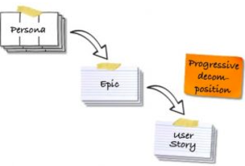

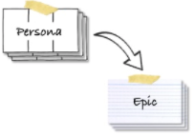
User Story Development Workflow
2 Derive Epics from the Persona Goals
3 Progressively Refine the Epics into User Stories
1. Start with Personas
Personas offer a great way to capture the users and the customers with their needs.
An epic is a big, sketchy, coarse-grained story.
Starting with epics allows you to sketch the product functionality without committing to the details.

Slide 50
Start with Epics
An epic is a big, sketchy, coarse-grained story.
It is typically broken into several user stories over time, leveraging the user feedback on early prototypes and product increments.
You can think of it as a headline and a placeholder for more detailed stories.
Starting with epics allows you to sketch the product functionality without committing to the details. This is particularly helpful for describing new products and features.
Not all stories necessarily need to fit under an epic.

Slide 51
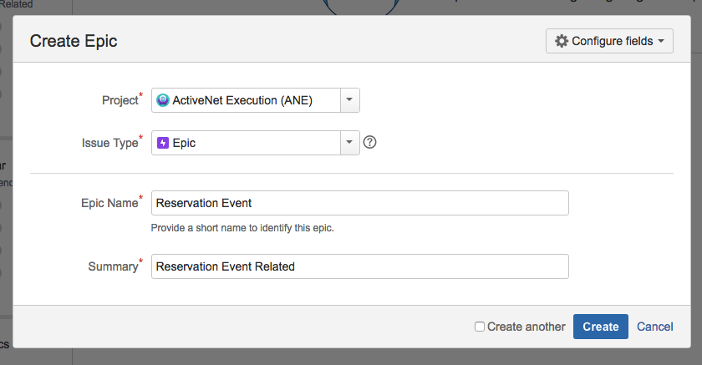
Create an Epic in Jira

Slide 52
What is a user story?
User stories are short, simple descriptions of a feature told from the perspective of the person who desires the new capability, usually a user or customer of the system. They typically follow a simple template:
As a <type of user>, I want <some goal or objective>, so that <benefit, value>.
User Story is only meant to describe a feature, but not describe how to implement it, meaning leaving out the technical aspect, it should describe the behavior or flow from user’s perspective.

Slide 53
Acceptance Criteria
Acceptance criteria complement the narrative and clarify the conditions that need to be fulfilled in order for testing and acceptance of the story.
QA should use the acceptance criteria to develop test cases and test plans.
Developers should implement the story specifically to satisfy these conditions and pass the test plans developed by QA.
Business Analysts should use the acceptance criteria to confirm it is “done” and sign-off for closure.

Slide 54
“Definition of Done” Checklist
This checklist indicates Active’s minimal criteria for Doneness. Teams should develop their own Definition of Done and continue to add to it as they mature.
Ready to be groomed:
User story and acceptance criteria clearly documented
Ux design completed and locked
User story meets the INVEST criteria

Slide 55
“Definition of Done” Checklist
Ready to be pulled into a sprint:
Visual design completed and locked
All pre-requisites complete
All dependencies identified, linked and planned

Slide 56
“Definition of Done” Checklist
Done:
Dev Complete
Code complete
Unit test cases written and all pass
Code review
Documentation written
Merge Request Created
Remaining hours set to zero
All Dev subtasks marked as complete or resolved
User story assigned to QA

Slide 57
“Definition of Done” Checklist
Done:
QA Acceptance
Functional testing
Regression testing
Integration testing
Performance testing
All P1/P2s fixed
All QA subtasks marked as complete or resolved
User story assigned to BA or Product Manager

Slide 58
“Definition of Done” Checklist
Done:
Product Acceptance
Functional review (demo)
User story marked as complete or resolved
User story meets the Acceptance Criteria as documented in the ticket

Slide 59
“Definition of Done” Checklist
Done:
Release
Code deployed to Production
QA smoke test and sign-off

Slide 60
Invest criteria for user stories
Independent
Negotiable
Valuable
Estimatable
Small
Testable

Slide 61
Independent
Independent user stories minimize the impact of changes to the developing product.
User stories are the lowest level of functional decomposition.
They are vertical slices of functionality that can be experienced by a user.
They are expressed from the view of a persona (user, admin, etc).
Their goal is to facilitate a discussion between Product Owner and Agile Team (collaboration) that results in a better understanding of business needs and a better understanding of the most efficient way to achieve the business needs.

Slide 62
Negotiable
User stories should be negotiable.
The negotiation is a collaboration that leads to an improved understanding of the requirement and the most efficient way of meeting the defined business need.

Slide 63
Valuable
User stories should have business value.
They should be an increment of product that can be demonstrated or experienced by the user.

Slide 64
Estimatable
There should be enough detail that the team feels comfortable providing an estimate.
Early in the refinement process, estimates can be “high level,” meaning there are still some details that are unknown or undetermined, but enough is known to get a reasonable estimate that’s accurate within a percentage margin of error.
As the story is committed into a sprint, the details must be clear enough that the team can add subtasks for all of the work and estimate hours for each subtask.

Slide 65
small
Small stories are more predictable and easier to estimate the effort.
They are less complex to test and therefore more likely to be high quality.
They reduce the amount of technical debt accumulated and make it easier to address quickly.
They allow for quicker feedback and minimize the potential for waste, as feedback can be incorporated more quickly.
Stories may start large and be sliced into smaller pieces throughout the refinement process.

Slide 66
Testable
User stories must be testable.
Testability is defined before the story is pulled into a sprint using Acceptance Criteria.
They clarify exactly what needs are being met and how we will verify it.

Slide 67
Spike
A spike is a task aimed at answering a question or gathering information, rather than producing a shippable product increment.
A spike should be time boxed.
The output of a spike should be clearly defined. For example, a prototype or a detailed analysis of two options with clearly defined acceptance criteria.
Spikes can be used to research how to implement a story and the output may include a story point value for the original story.

Slide 68
Estimating the Backlog

Slide 69

Estimate the size of the Chinese zodiac

Slide 70

We are not good at estimating, we are good at comparing

Slide 71
Story Points
Relative measure of size
It’s time (effort), not complexity alone
Unit-less
Basic Math Properties still hold (8 + 3 = 11)
Allows estimation to be completed independent of time

Slide 72
Units of measure
0, ½,1, 2, 3, 5, 8, 13, 20, 40, 100
Relative complexity and size are more difficult to measure the larger they get.
Drives faster estimates during grooming.

Slide 73
What is 1 Story Point?
Humans can really only comprehend 1 order of magnitude
Choose your scale wisely
Accuracy decreases with distance
0 1 2 3 5 8 13 20 40 80 100
Text Change
Largest New Feature

Slide 74
Story Point Guidelines
1 – easy text change
3 - small
5 - medium
8 – difficult medium
13 – large
20 – difficult large
40 – too large, needs to be split in 2
100 – epic, needs to be broken into several user stories

Slide 75
Story Point Baseline
Example stories for each unit of measure
Allows the team to ensure story point measurements remain consistent over time
Allows the team to communicate the relative measure of each unit to new scrum team members
Ensures consistent measurements from all team members

Slide 76
Planning Poker
An iterative approach to estimating
Steps
Each estimator is holding cards with valid numbers
Product owner reads a story and it’s discussed briefly
Each estimator selects a card (estimate)
Estimators show cards all at the same time
Estimators discuss differences (especially outliers)
Re-estimate until estimates converge

Slide 77
Main Benefits of Planning Poker
Fosters collaboration by engaging entire team
Creates consensus estimate rather than having a single person driving the estimate
Exposes issues early through discussion of each user story
Knowledge sharing

Slide 78
Tips for Planning Poker
Only the scrum team members that will do the work and test it are allowed to vote.
Managers, Product Managers, BAs and Project Managers don’t vote.
When there is a tie in the voting between two sizes which are consecutive, just pick the larger size or size closest to the voted size and move on.
If consensus cannot be reached by the end of the third round of voting pick the largest size and move on.
Stop implementation discussions before they go too deep
Use a timer of some sort to limit discussion
Have fun!

Slide 79










Planning Poker

Slide 80
Additional PMO Topics

Slide 81
Success metrics
QA Management:
Production Bug Backlog (Number per Week by Severity)
QA Defects Found (Number per week by Severity)
Customer Reported Bugs in Production (Number per Week by Severity)
Hot Fixes (Number per Week)
Escape Rate (per Week)

Slide 82
Success metrics
Dev Charts:
SP Completed per Sprint
SP Completed/SP Committed
Defects/SP
SP/Person/Day
Utilization

Slide 83
Success metrics
Static Code Analysis:
Code Complexity
Function Complexity
Code Duplication
Unit Test Coverage

Slide 84
Executive Dashboard
Means of communicating about a project
Source of truth for project-related details
Main Page, Dev Metrics, Scrum Teams and Burndown Charts owned by the Project Manager
Risks are reviewed on a daily basis by the PMO Director
Risks are reviewed by the CTO and Development/QA leadership twice weekly
Key metrics that are important to the leadership team are shown on the QA Management, Dev Charts and Static Code Analysis pages
Teams are measured against these metrics and should be able to speak to trends and spikes

Slide 85
Roadmap Visibility
Active requires a 90-day rolling view of upcoming roadmap to be presented to the development team.
Each sprint should be locked and ready to develop three weeks prior to its start.
The next 3-5 sprints should be in the process of refinement from high level summaries to epics to user stories.
A backlog of fully groomed, prioritized user stories to fill the current sprint plus two more sprints is required at all times.

Slide 86
Commitments
Commitments are an important part of project planning and execution.
Teams are required to commit to the contents of a sprint as it is locked and to a 90 day rolling, high level roadmap.
Resources are required to commit to a schedule during project planning.
If you are unable to make a commitment, you need to provide a reason and allow the team to mitigate.
Once you make a commitment, you are required to keep it.
If you are unable to keep the commitment, you must immediately notify the Project Manager and participate in an impact analysis, risk mitigation and re-planning exercise.

Slide 87
Change Requests
Change request are required in the following circumstances:
Major change in the 90 day roadmap after it has been presented to the executives and/or planned and committed to the dashboard.
Major change in the contents of a sprint after it has been locked. 10% is the general guideline that accounts for PTO or minor project risks.
Any change to a committed Key Milestone.
Any time a committed date will be missed. (Early is ok as long as the impacts are planned and accepted.)
Change requests are coordinated by the Project Manager.

Slide 88
Project Health
Green
Project is currently on schedule and managed.
No issues are flagged for escalation.

Slide 89
Project health
Yellow
There is risk to Scope, Schedule or a Key Milestone, but it is being managed.
No direct assistance from management is required.
Project Managers should lead the team in the development of a mitigation plan and create a sense of urgency to bring closure to all issues as quickly as possible.
Project Managers should inform the project and PMO leadership of the yellow status and provide periodic updates.
Project Managers should record this information in the executive dashboard in all affected sections.

Slide 90
Project health: red
Red
Scope, Schedule or a Key Milestone is in jeopardy.
Mitigation actions failed to resolve the issue.
Management assistance required through escalation process.
If the team will miss a date that’s committed to the dashboard, by definition it is Red.
In many cases, this will require a Change Request.

Slide 91
The End

